Slide 1
Liver Disease Prediction
Group 2: Selina Meng; Tianchuzi Qin;
Tina Zhang; Yuyang Chen

Slide 2
Executive Summary
Liver disease is a major global health issue requiring early detection and management.
Dataset Overview
Kaggle dataset: Liver Disease Patient Dataset 30K Training Data.
Two subsets:
Train: 20K samples, 10 features (e.g., total bilirubin, albumin, demographics).
Test: ~1K samples.
Exploratory Data Analysis (EDA)
Analyzed relationships between biochemical markers and liver disease.
Identified patterns & trends to guide model selection.
Examined feature importance for predictive power.
Data Preparation & Processing
Handled missing values & outliers to ensure data integrity.
Encoded categorical variables for machine learning compatibility.
Scaled numerical features for better model performance.
Extracted key features to improve prediction accuracy.
Model Evaluation
Four models tested:
Logistic Regression
Random Forest
KNN
FNN

Slide 3
Problem Statement/Research objective(s)
Problem Statement: prediction for liver disease can help improve treatment outcomes and reduce complications.
Traditional diagnostic methods: invasive, time-consuming, and costly.
Machine learning (ML) techniques:analyze medical data
Research Objectives: Develop a predictive model for liver disease using machine learning methods.
Use clinical biomarkers to assess liver health.
Perform feature engineering to identify the most important predictors.
Compare different machine learning models
Visualize and interpret model predictions to provide insights

Slide 4
Literature Review
Key Concepts:
Demographic Features: Age and Gender of patients.
Liver Function Indicators: Bilirubin, Alkaline Phosphatase, ALT (SGPT), AST (SGOT), and Proteins.
Related Studies:
Previous research utilized conventional regression models with c-statistics around 0.60.
The HALT-C trial as a comparative benchmark for evaluating predictive models.
Studies emphasizing the role of hepatitis C and non-alcoholic fatty liver disease (NAFLD) in increasing HCC risk.
Research Gap:
Existing studies have paid insufficient attention to feature extraction and hyperparameter tuning methods for high-dimensional data.
The small sample size and category imbalance problem lead to limited model generalization ability.
There is a lack of in-depth research on the application of FNN and integrated models in liver disease prediction.
Rationale:
Machine learning models show higher AUC and accuracy in experiments.
Overfitting and false positive rates were effectively reduced by feature selection and data balancing techniques.

Slide 5
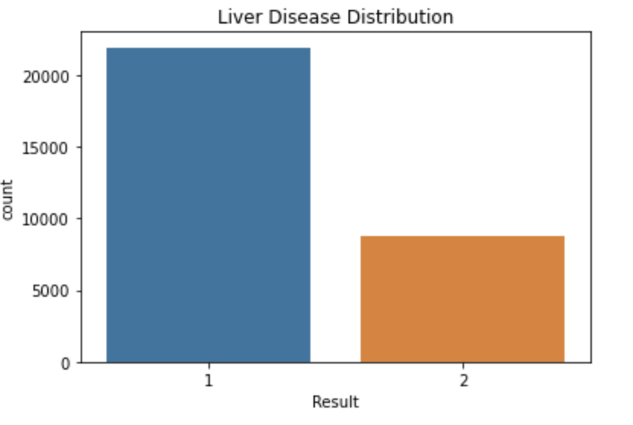
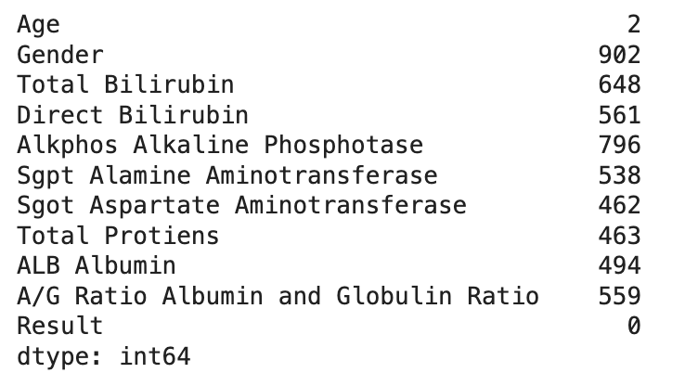
Exploratory Data Analysis
Gender has the most missing values -902
Other variables like total and direct bilirubin also have significant missing value

Slide 6
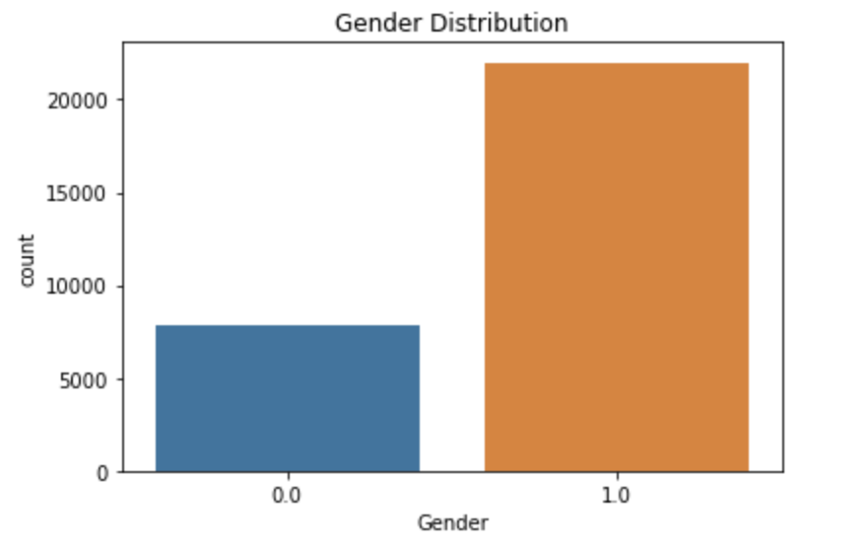
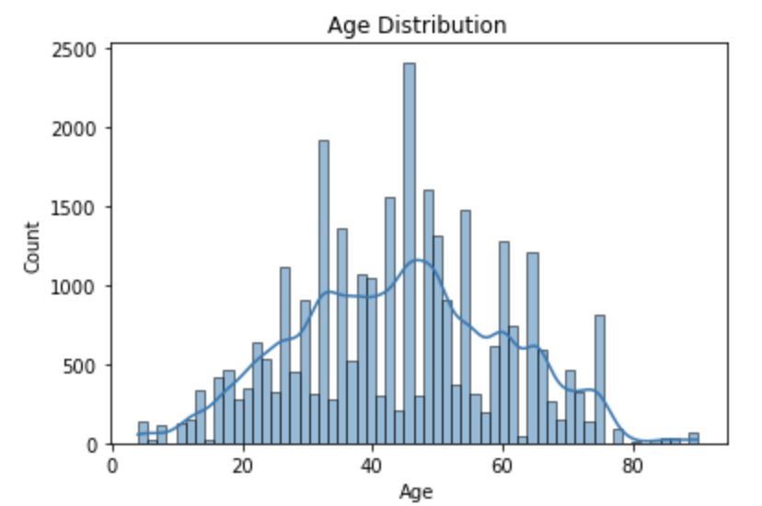
Male = 1
Female = 0
Mean age: 44, Median age: 45
Primarily aged 30-60, concentrated between 40-50
Men may be at higher risk

Slide 7
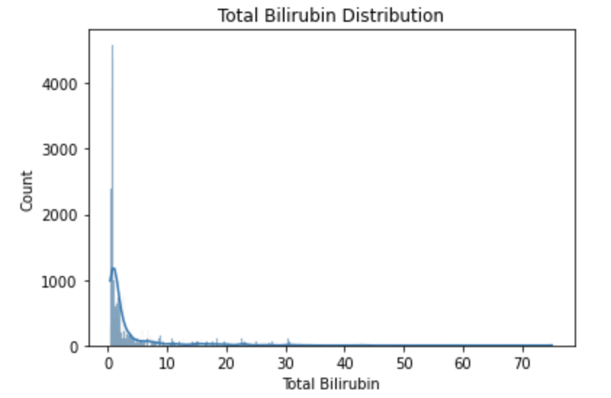
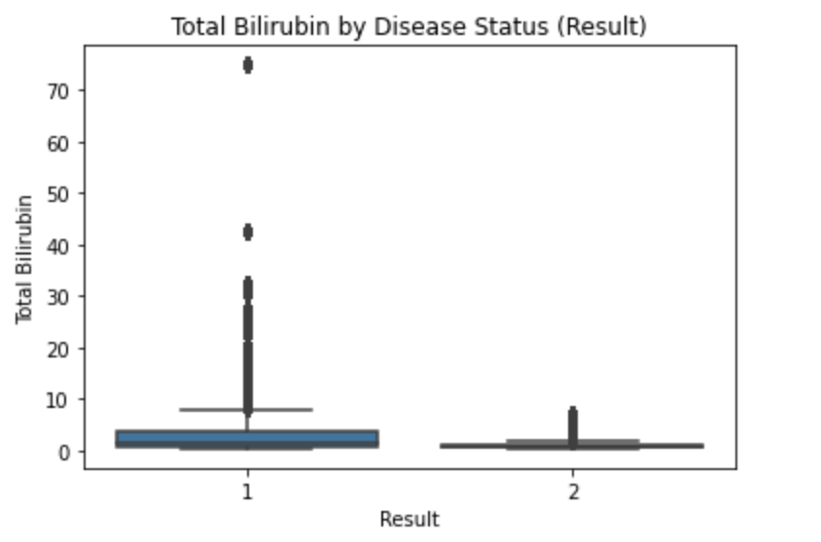
Right-skewed with many extreme values showing rare liver diseases

Slide 8
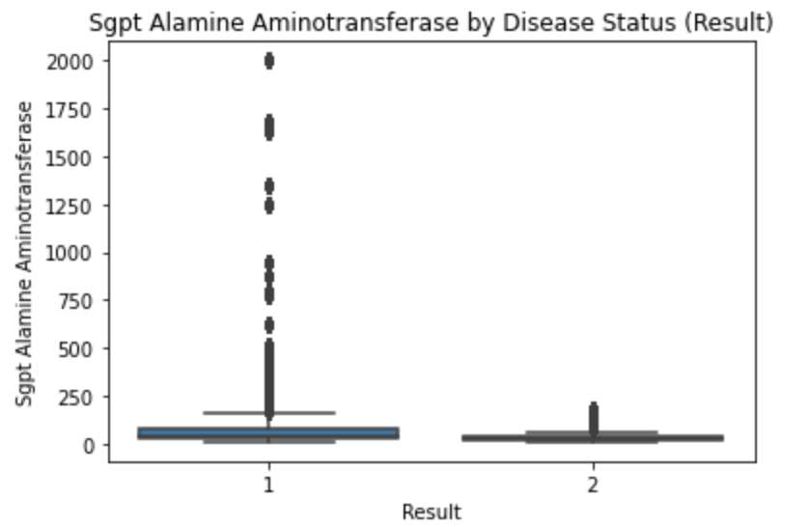
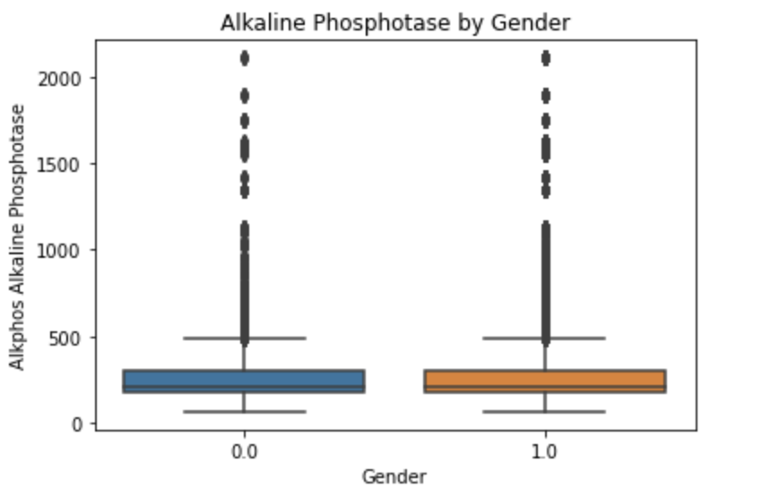

Slide 9
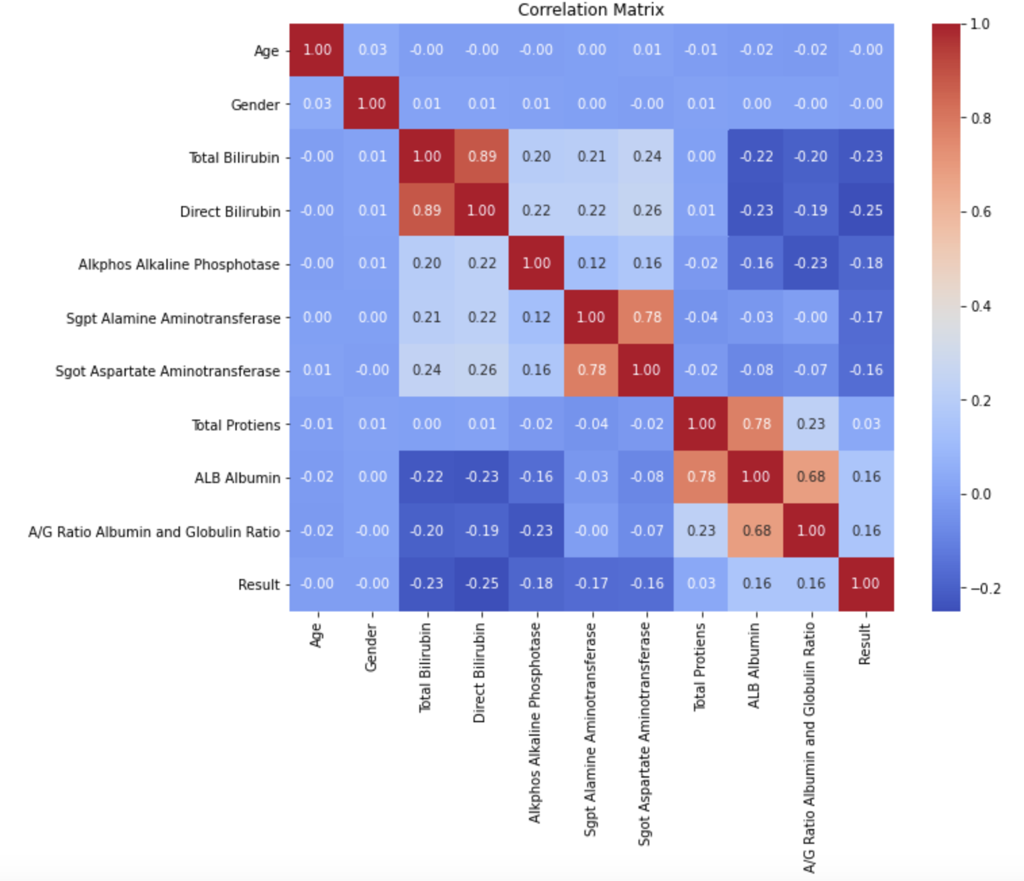
Bilirubin: Negative correlation with liver disease
Albumin and Total Proteins: Weak positive correlation, low levels indicate higher likelihood of liver disease
High correlation between total bilirubin and direct bilirubin.

Slide 10
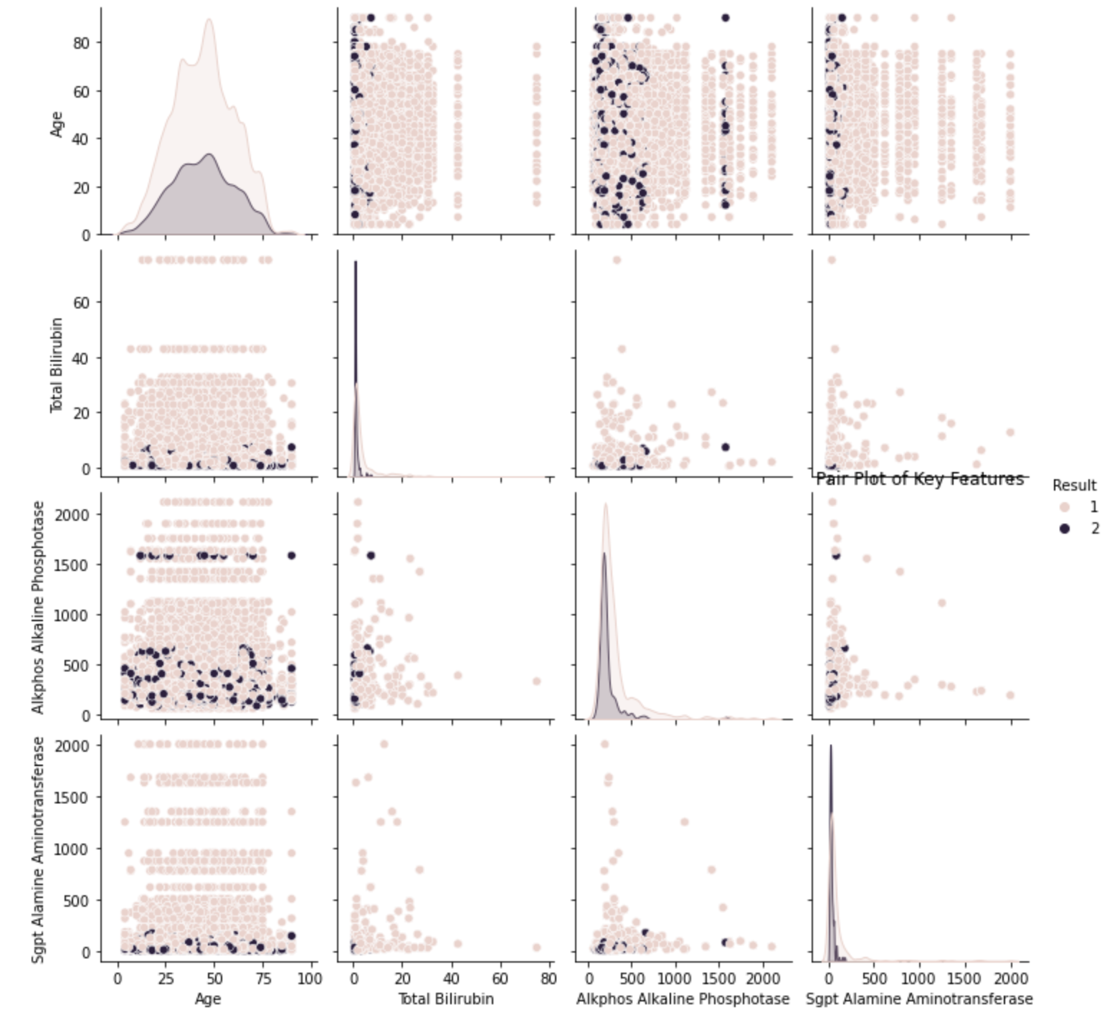
liver disease (category 1) were more frequent in people with higher levels of Alkaline Phosphatase and SGPT Aminotransferase, suggesting that these indicators may be important markers of liver disease.
the plot shows that the correlation among these features is generally weak, suggesting that these features can provide different information and reduces the problem of feature redundancy.

Slide 11
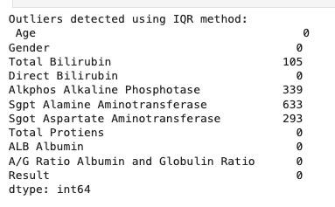
Clean data
Clean Outliers
lower = quantile(0.05) Upper = quantile(0.95)
clip(lower, upper)--- Cap outliers at the 5th and 95th percentile for selected features
Clean missing values
Gender – Mode
Other numerical columns – Median

Slide 12
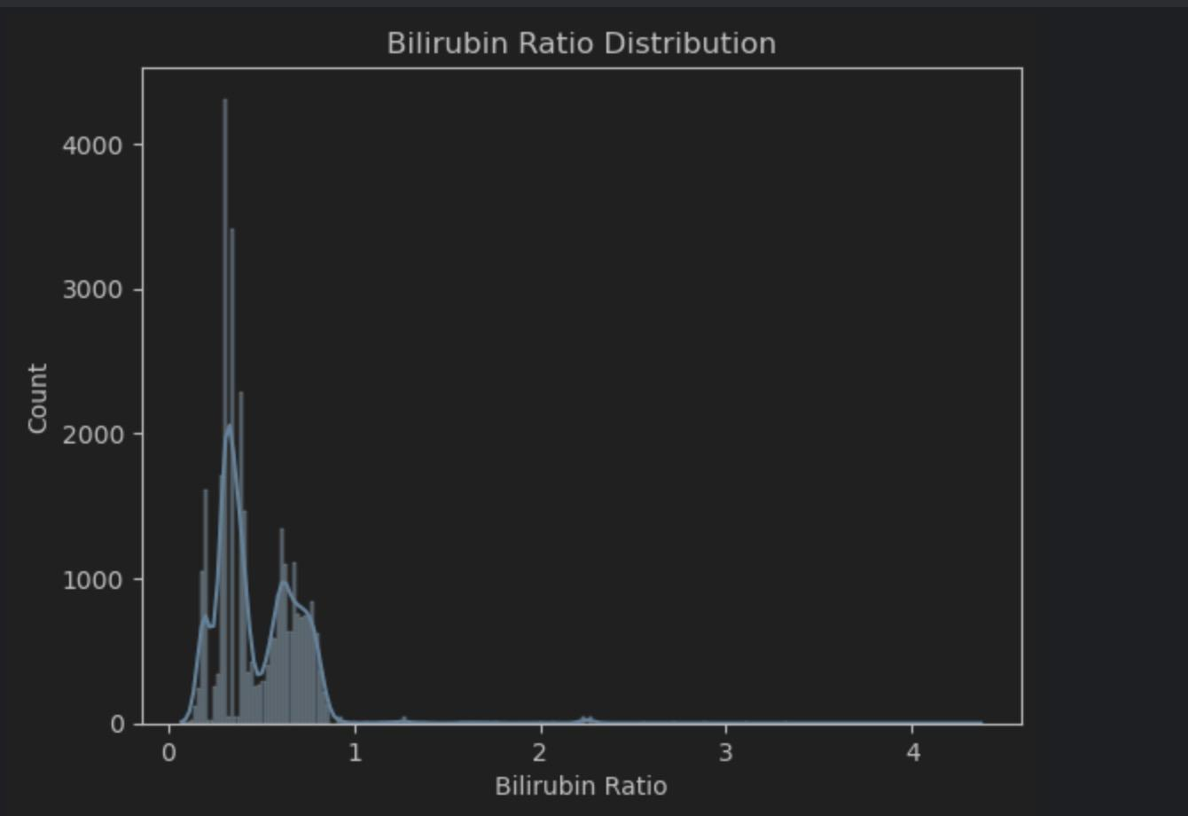
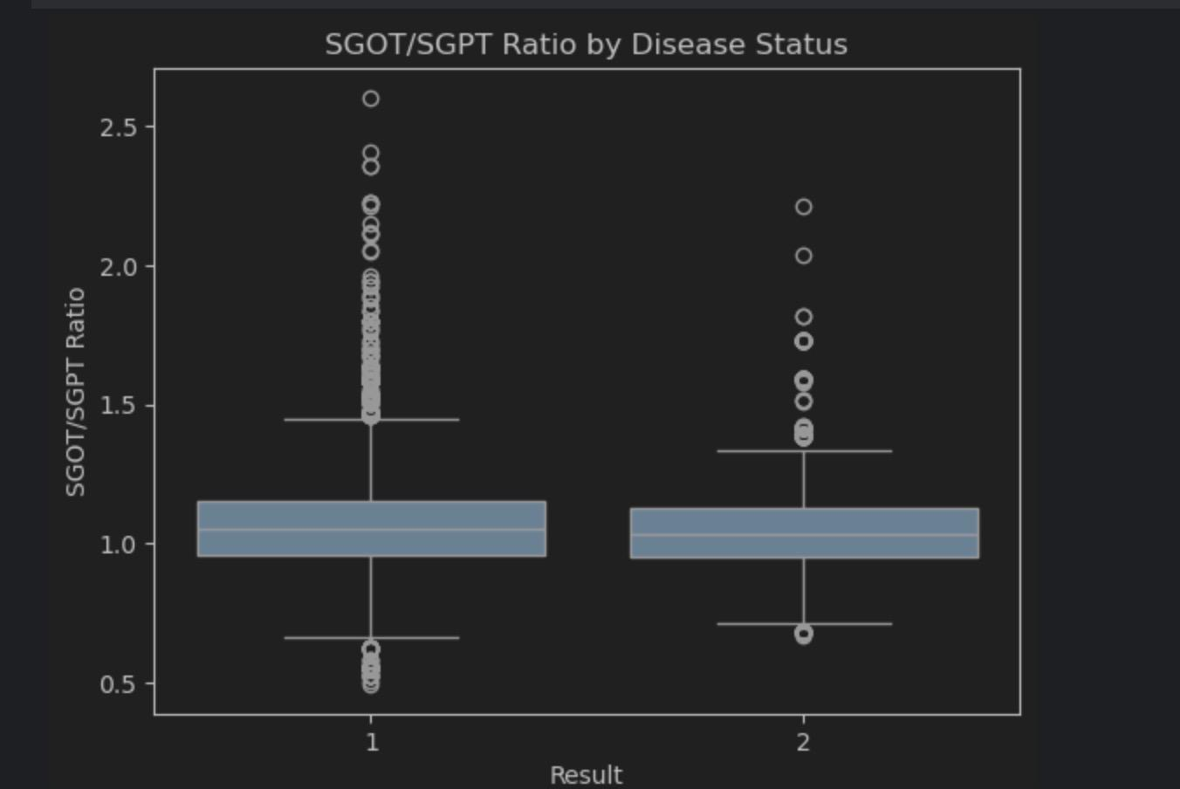
Data Preparation/Feature Engineering
New feature:
SGOT/SGPT Ratio:“De Ritis ratio”, medically;determine the type of liver injury.
Bilirubin Ratio：cholestasis and abnormal liver function
Protein Ratio:Dysfunction of white matter synthesis and catabolism
right skewed distribution
The median is very close

Slide 13
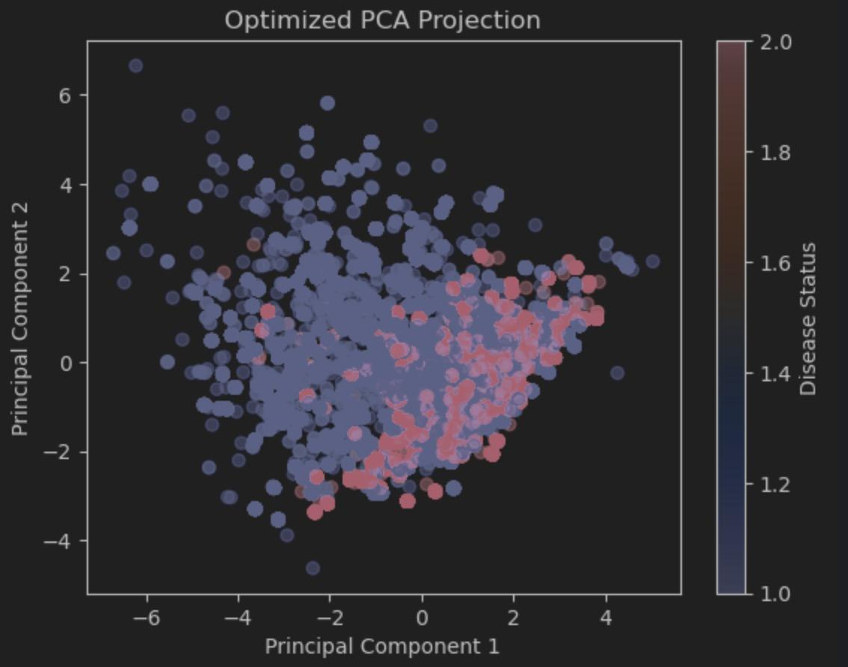
Use random forest +RFE(recursive feature elimination)to select top ten features and do PCA:
total bilirubin
alkphos alkaline phosphotase
sgpt alamine aminotransferase
sgot aspartate aminotransferase
total protiens
alb albumin
a/g ratio albumin and globulin ratio
bilirubin ratio
sgot/sgpt ratio
protien ratio
Random forest:
1.capture non-linear relationships
2.not sensitive to outliers in dataset

Slide 14
Methodology
Models Chosen:
Logistic Regression, Random Forest, Feedforward Neural Network(FNN), K-Nearest Neighbors(KNN)
Log Regression with Hyperparameter Tuning
Interpretable, efficient for small to medium-sized data.
Random Forest (with and without PCA)
Robust to noise, handles non-linear relationships, provides feature importance.
FNN with Hyperparameter Tuning
Capture complex non-linear relationships and adapt to high-dimensional data..
KNN with Hyperparameter Tuning
Captures local patterns effectively and adapts to complex decision boundaries.

Slide 15
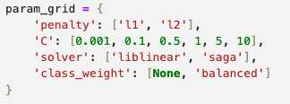
Logistic Regression with Hyperparameter Tuning
penalty: Controls regularization type to prevent overfitting.
L1: Ridge; l2: Lasso
C: Controls regularization strength.
Lower C means stronger regularization; higher C captures more details but risks overfitting.
solver: Specifies the optimization algorithm to use for minimizing the loss function.
liblinear: Suitable for small datasets
saga: Efficient for large datasets
class_weight: Addresses class imbalance in the dataset.
None means no class imbalance adjustment; balanced adjusts weights inversely to class frequencies.

Slide 16

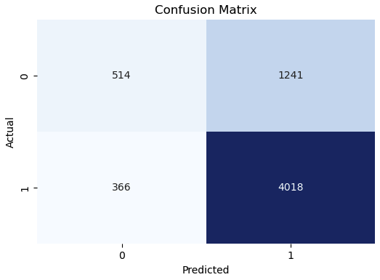
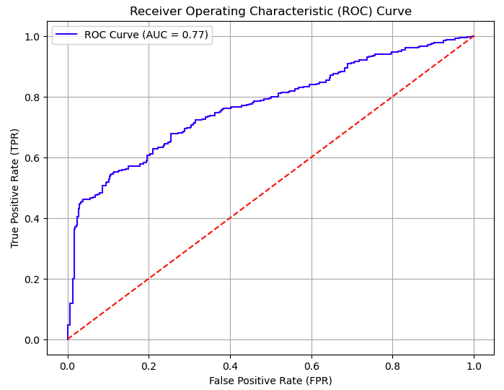
Logistic Regression
Evaluation
Test Accuracy: 73.8
High TP; High FP; Low FN AUC = 0.77; Balanced TPR and FPR

Slide 17
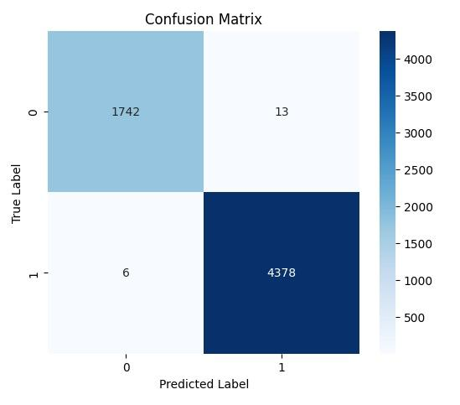
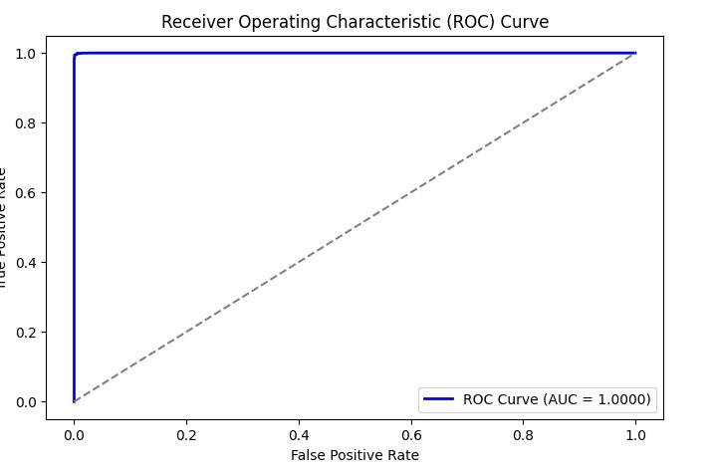
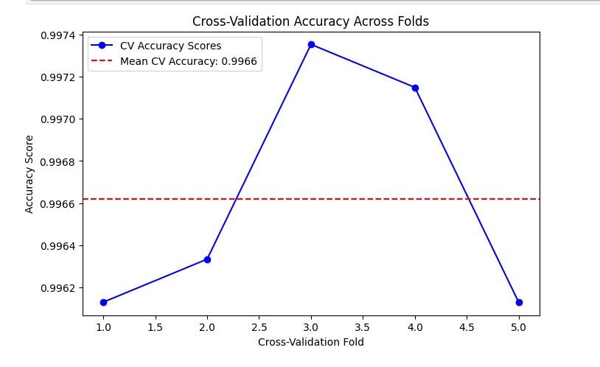
Random Forest --n_estimators=100, random_state=42
Training Accuracy: 0.9999
Test Accuracy: 0.9969050333930608

Slide 18
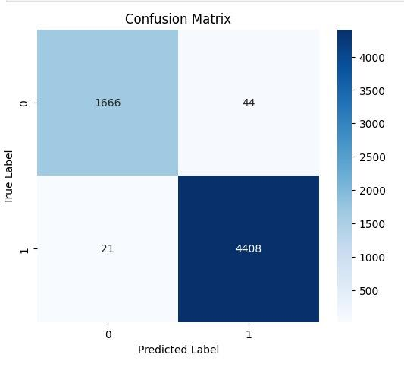
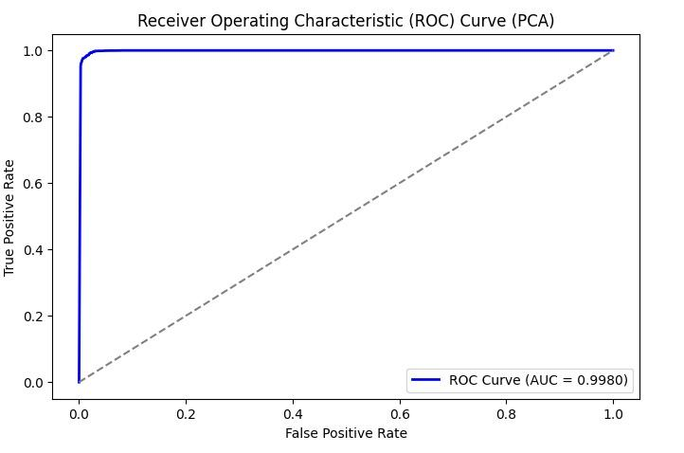
Random Forest By PCA
n_estimators=100, random_state=42
Training Accuracy: 0.9999
Test Accuracy: 0.9894119563446816

Slide 19
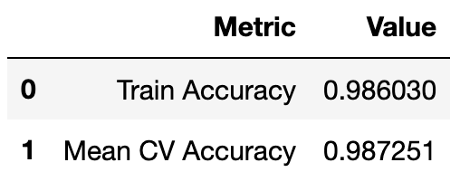
FNN
Compute Class Weights
Stratified K-Fold (k=5)
Early Stopping
Hidden Units | 64 | 128 | 256
Dropout Rate | 0.1 | 0.3 | 0.5
Learning Rate | 0.001 | 0.0005 | 0.0001

Slide 20
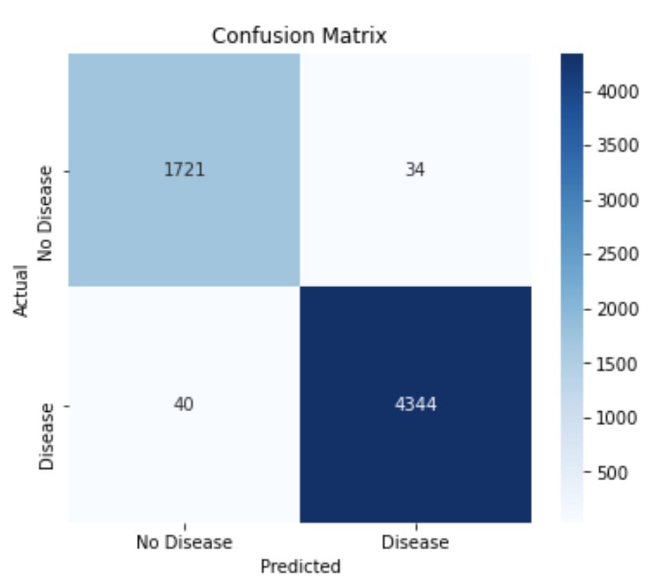
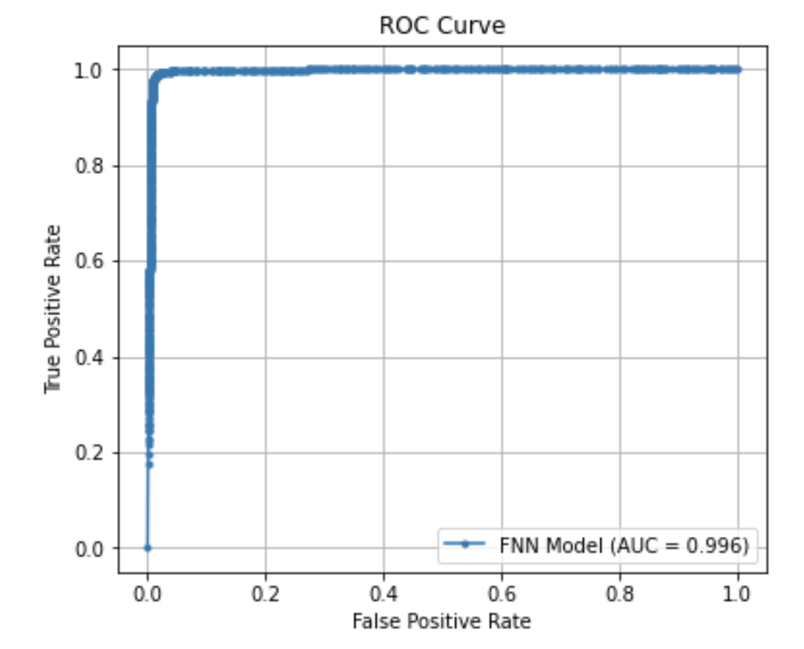
FNN
Units: 256, Dropout: 0.1, LR: 0.0005
Training Accuracy: 0.9860
Test Accuracy: 0.9879

Slide 21
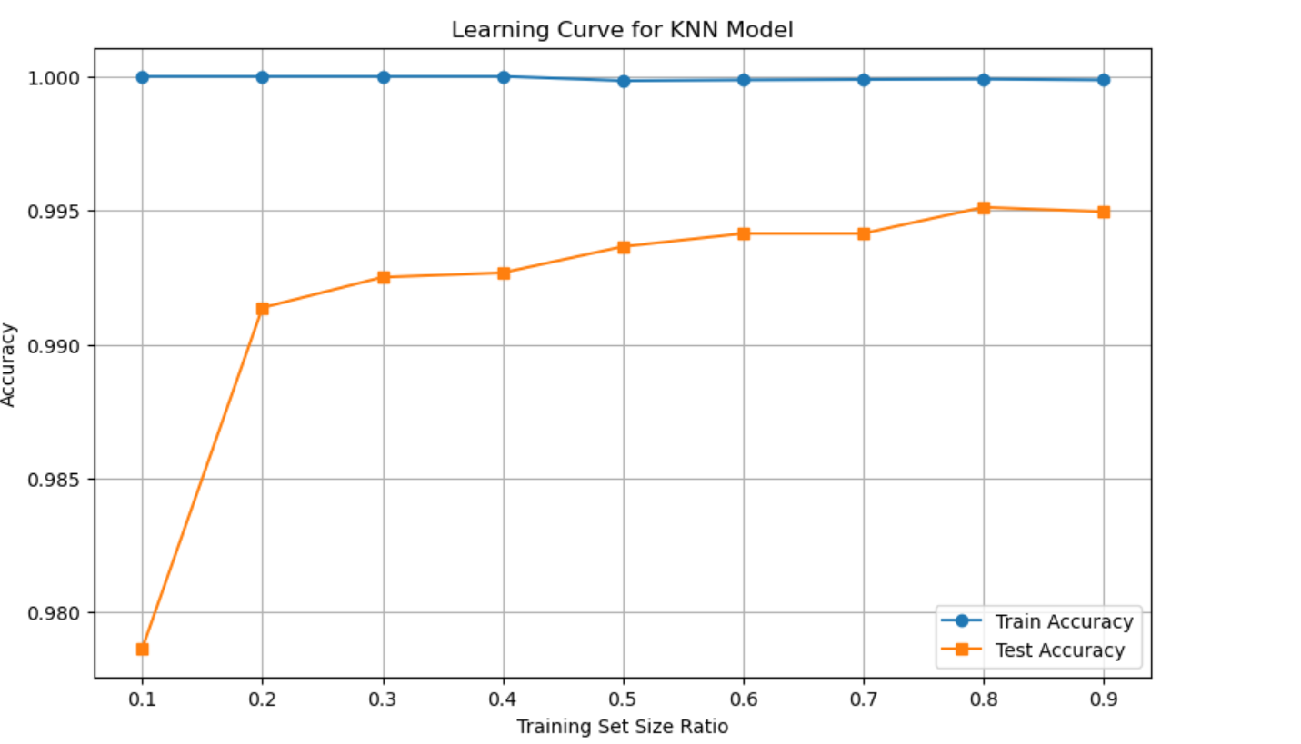
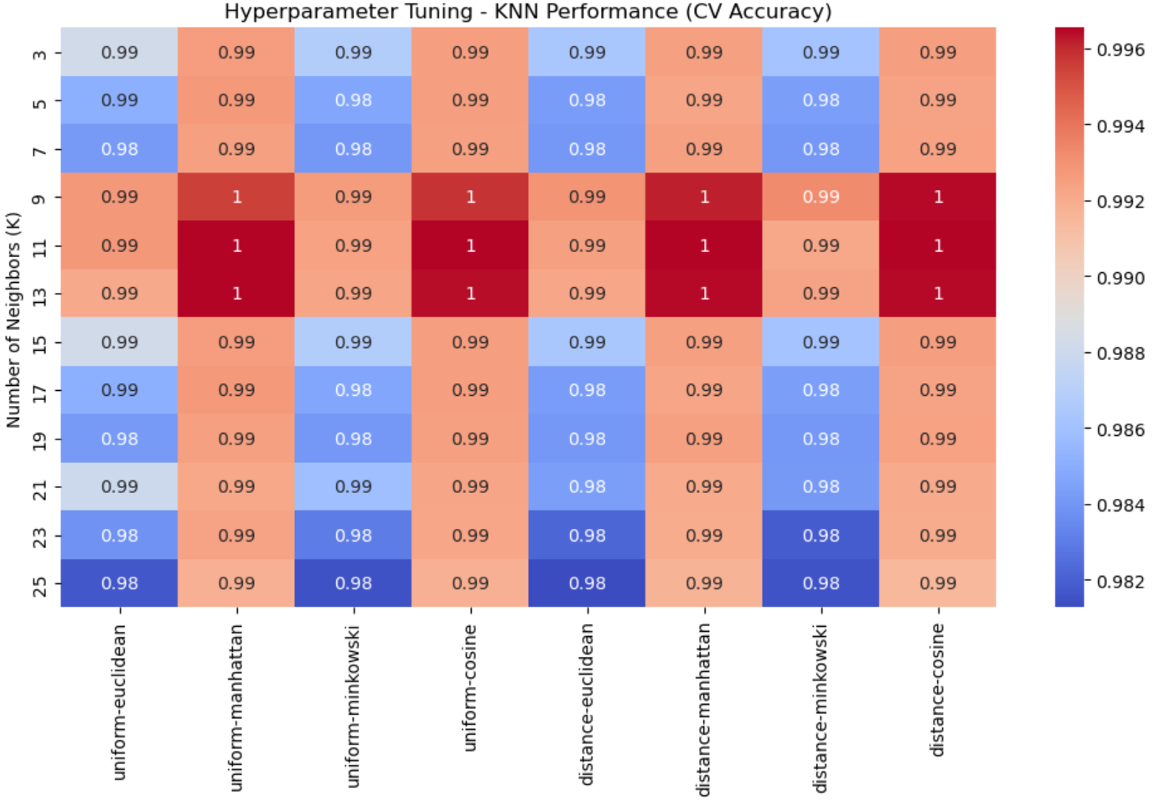
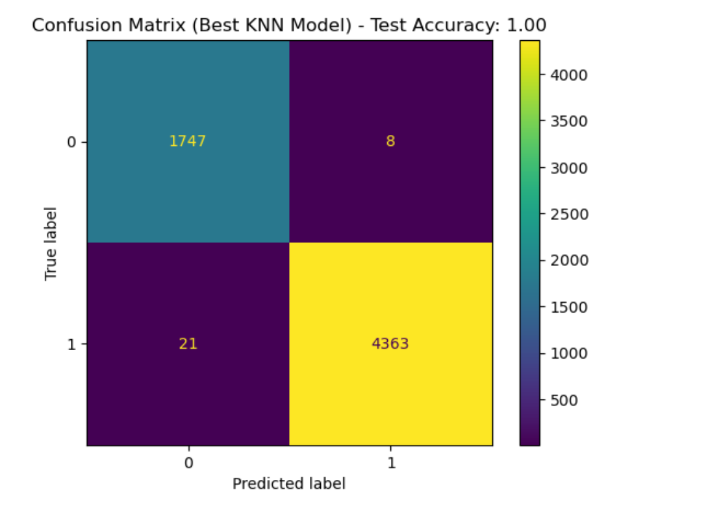
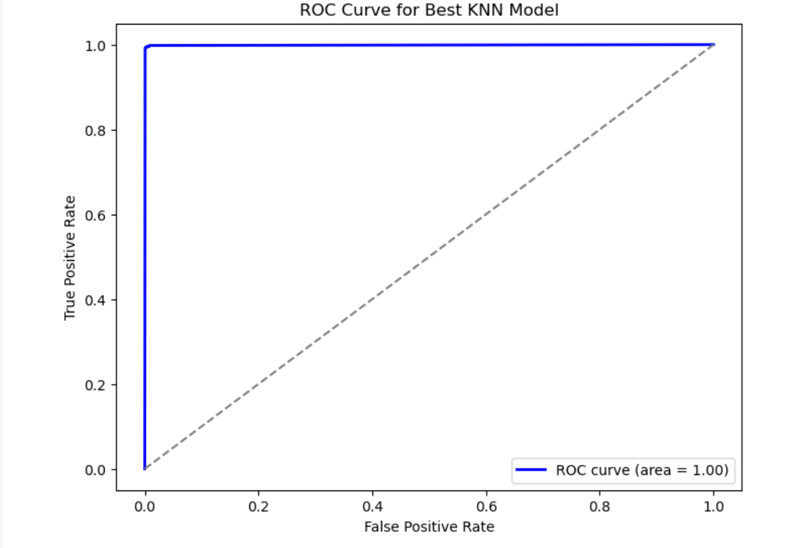
KNN

Slide 22
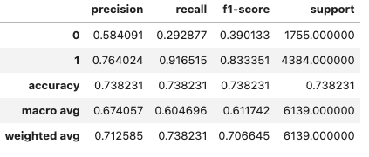
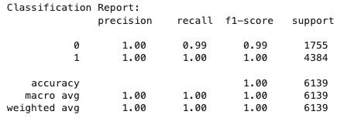
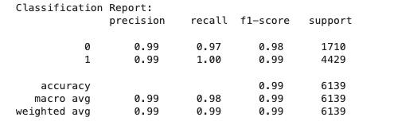
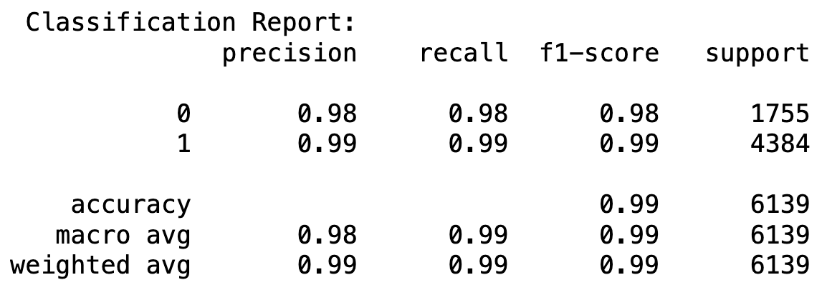
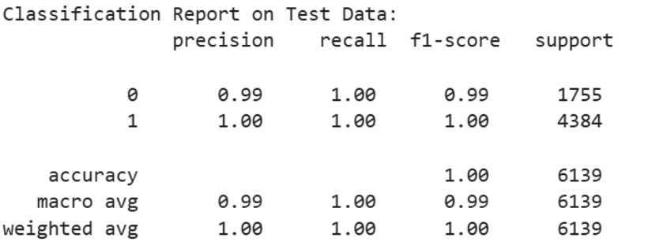
Conclusion
Logistic regression models are not suitable：non linear relationship
Logistic
Random Forest
With pca
FNN
KNN

Slide 23
Limitation
Data Imbalance:
Dataset has more non-disease cases than disease cases, the model might become biased
Feature Availability:
Some important features like lifestyle habits and medication history were not included
Overfitting Risk:
Dropout, early stopping, regularization, and cross-validation are needed to improve generalization
Interpretability:
Deep learning models such as FNNs do not provide clear explanations for predictions
Hardware:
Hyperparameter tuning and cross-validation on large datasets requires GPUs for processing

Slide 24
Our Team
Tina
Tianchuzi
Selina
Yuyang
EDA
Logistic Regression
Model Evaluation
Slides
Essay
Feature Engineering
Random Forest
Model Evaluation
Slides
Essay
EDA
FNN
Model Evaluation
Slides
Essay
Feature Engineering
KNN
Model Evaluation
Slides
Essay

Slide 25
Reference
Amin, Ruhul, Rubia Yasmin, Sabba Ruhi, Md Habibur Rahman, and Md Shamim Reza. “Prediction of Chronic Liver Disease Patients Using Integrated Projection Based Statistical Feature Extraction with Machine Learning Algorithms.” Informatics in Medicine Unlocked 36 (2023): 101155-. https://doi.org/10.1016/j.imu.2022.101155
El–Serag, Hashem B, and K. Lenhard Rudolph. “Hepatocellular Carcinoma: Epidemiology and Molecular Carcinogenesis.” Gastroenterology 132, no. 7 (2007): 2557–76. https://doi.org/10.1053/j.gastro.2007.04.061.
Jaiswal, Ankur, Ritika Agrawal, and Surya Prakash. “Improved Liver Disease Prediction from Clinical Data through an Ensemble Learning Model.” BMC Medical Informatics and Decision Making 24, no. 1 (2024): 1–12. https://bmcmedinformdecismak.biomedcentral.com/articles/10.1186/s12911-024-02550-y.
Kang, Baeki E, Aron Park, Hyekyung Yang, Yunju Jo, Tae Gyu Oh, Seung Min Jeong, Yosep Ji, et al. “Machine Learning-Derived Gut Microbiome Signature Predicts Fatty Liver Disease in the Presence of Insulin Resistance.” Scientific Reports 12, no. 1 (2022): 21842–21842. https://doi.org/10.1038/s41598-022-26102-4.
Liu, Mei, Fei Zhang, and Ping Li. “Machine Learning Models for Predicting Non-Alcoholic Fatty Liver Disease.” World Journal of Hepatology 13, no. 10 (2023): 1500–1510. https://pmc.ncbi.nlm.nih.gov/articles/PMC8568572.
Liu, Yuan-Xing, Xi Liu, Chao Cen, Xin Li, Ji-Min Liu, Zhao-Yan Ming, Song-Feng Yu, et al. “Comparison and Development of Advanced Machine Learning Tools to Predict Nonalcoholic Fatty Liver Disease: An Extended Study.” Hepatobiliary & Pancreatic Diseases International 20, no. 5 (2021): 409–15. https://doi.org/10.1016/j.hbpd.2021.08.004.
Lu, Chien-Hung, Weu Wang, Yu-Chuan Jack Li, I-Wei Chang, Chi-Long Chen, Chien-Wei Su, Chun-Chao Chang, and Wei-Yu Kao. “Machine Learning Models for Predicting Significant Liver Fibrosis in Patients with Severe Obesity and Nonalcoholic Fatty Liver Disease.” Obesity Surgery 34, no. 12 (2024): 4393–4404. https://doi.org/10.1007/s11695-024-07548-z.
Shrivastava, Abhishek. “Liver Disease Patient Dataset.” Kaggle. Accessed March 10, 2025. https://www.kaggle.com/datasets/abhi8923shriv/liver-disease-patient-dataset/data.
Singal, Amit G, Ashin Mukherjee, B Joseph Elmunzer, Peter D R Higgins, Anna S Lok, Ji Zhu, Jorge A Marrero, and Akbar K Waljee. “Machine Learning Algorithms Outperform Conventional Regression Models in Predicting Development of Hepatocellular Carcinoma.” The American Journal of Gastroenterology 108, no. 11 (2013): 1723–30. https://doi.org/10.1038/ajg.2013.332.
Smith, John, Emily Taylor, and Anna Green. “Application of Machine Learning in Predicting Non-Alcoholic Fatty Liver Disease Using Body Composition and Anthropometric Measures.” Scientific Reports 13, no. 1 (2023): 8500–8510. https://www.nature.com/articles/s41598-023-32129-y.
Xiang, Kailai, Baihui Jiang, and Dong Shang. “The Overview of the Deep Learning Integrated into the Medical Imaging of Liver: A Review.” Hepatology International 15, no. 4 (2021): 868–80. https://doi.org/10.1007/s12072-021-10229-z.

